Slide 1
Digital Portfolio
STUDENT NAME: YUVANESH KUMAR.R
REGISTER NO AND NMID: 212402464 3B1CA26AA04E2BA980F4A4B0B6E72E92
DEPARTMENT: BCA
COLLEGE: Agurchand Manmull Jain College
UNIVERSITY :UNIVERSITY OF MADRAS

Slide 2
PROJECT TITLE
Digital Portfolio

Slide 3


AGENDA
Problem Statement
Project Overview
End Users
Tools and Technologies
Portfolio design and Layout
Features and Functionality
Results and Screenshots
Conclusion
Github Link
3/21/2024 Annual Review

Slide 4

PROBLEM STATEMENT
Discuss the problem your portfolio website addresses. (Example: "The need for a personalized platform to showcase web development projects and skills.")

Slide 5

PROJECT OVERVIEW
Provide a brief overview of your portfolio website. (Example: "A responsive portfolio website developed using HTML, CSS, JavaScript to showcase personal projects, education, and contact details.")

Slide 6

WHO ARE THE END USERS?
Describe who the users of the portfolio website are. (Example: "Potential employers, fellow developers, and anyone interested in learning more about my work.")

Slide 7

TOOLS AND TECHNIQUES
HTML
CSS
JavaScript
Open Weather Map API (for the weather app)

Slide 8
POTFOLIO DESIGN AND LAYOUT
Show how the design and layout are organized. You can include the screenshots of your portfolio here (based on the images you uploaded).
8

Slide 9
FEATURES AND FUNCTIONALITY
Personal Blog
Weather App
Portfolio Website

Slide 10
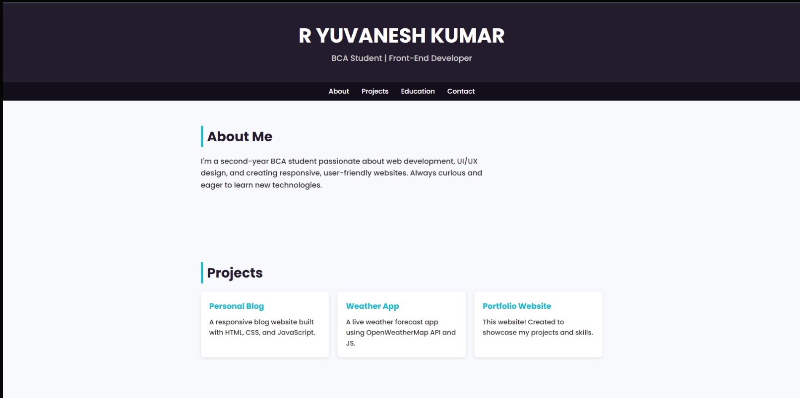

RESULTS AND SCREENSHOTS
Showcase screenshots from your website. You can add images of the actual projects and their layout as shown in the screenshots you provided.
3/21/2024 Annual Review
10

Slide 11
CONCLUSION
Brief summary of the project's impact and how it showcases your skills.
11

Slide 12
GITHUB LINK:
https://yuvaneshkumarr2005-lab.github.io/portfolio/
GITHUB Repositories
https://github.com/yuvaneshkumarr2005-lab/portfolio.git

